Slide 1
Mobility in
Cuyahoga County, Ohio
By: Michelle Hsieh

Slide 2
Problem Statement
Motivation: It’s a Human-Centered Problem
How has each phase of the pandemic affected where people go?
Observing people’s behavior and mobility changes over time provides insight into people’s perception of risk
We can potentially make inferences about mobility changes and COVID case peaks

Slide 3
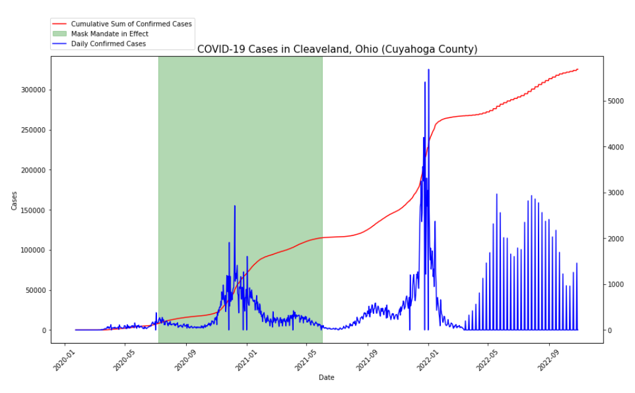
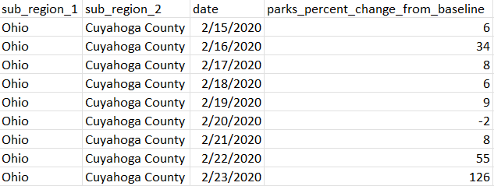
About the Data
COVID-19 Case Data:
Population: ~1.25M
Metropolitan: Cleveland, OH
Variables of Interest:
Date
# of cases
Mobility Data: measures the percentage change in location visitation from the baseline (January 2020)
Variables of Interest:
Date
Percentage change from baseline

Slide 4
Methodology
For each location category, we conduct t-tests to see if there is a significant difference in mean percentage change among the three time periods:
Before mask mandate vs. during mask mandate
During mask mandate vs. after mask mandate
Before mask mandate vs. after mask mandate

Slide 5
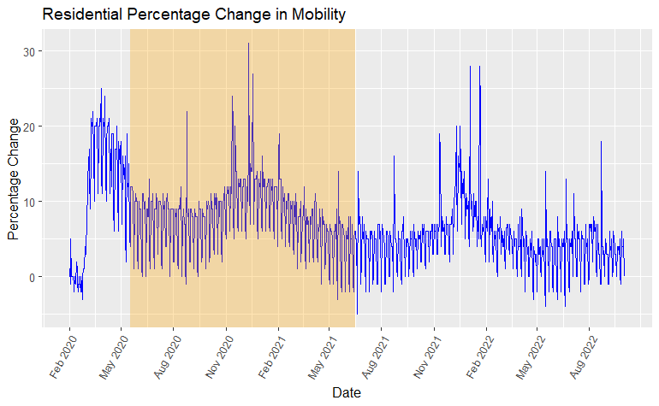
Results
Residential Areas Mobility:
Before mandate: 10.41% more than baseline
During mandate: 8.34% more than baseline
After mandate: 4.86% more than baseline

Slide 6
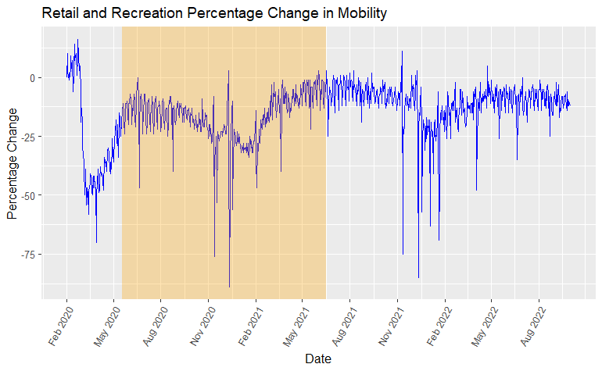
Results
Retail and Recreation Mobility:
Before mandate: 23.2% less than baseline
During mandate: 17.8% less than baseline
After mandate: 10.38% less than baseline

Slide 7
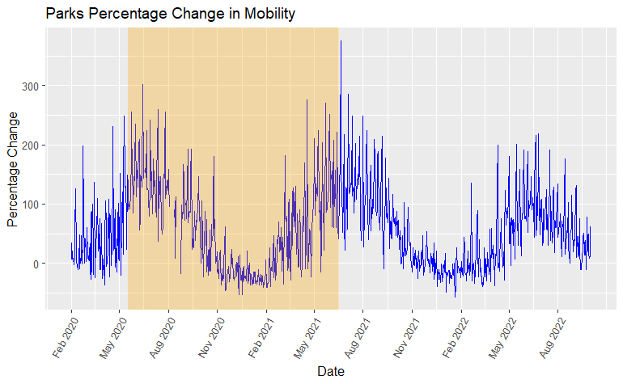
Results
Parks Mobility:
Before mandate: 66.56% more than baseline
During mandate: 48.23% more than baseline
After mandate: 57.51% more than baseline

Slide 8
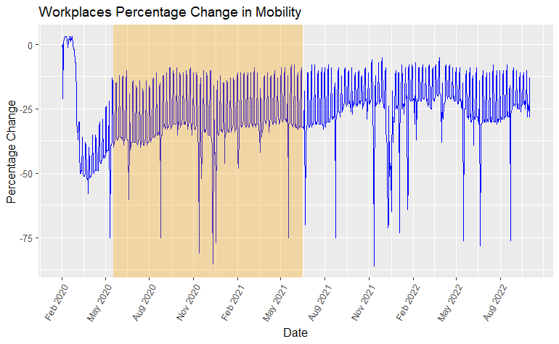
Results
Workplace Mobility:
Before mandate: 30.27% less than baseline
During mandate: 28.64% less than baseline
After mandate: 23.31% less than baseline

Slide 9
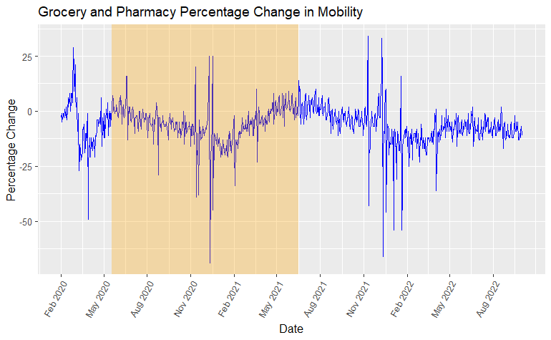
Results
Grocery Stores and Pharmacy Mobility:
Before mandate: 4.07% less than baseline
During mandate: 6.82% less than baseline
After mandate: 6.28% less than baseline

Slide 10
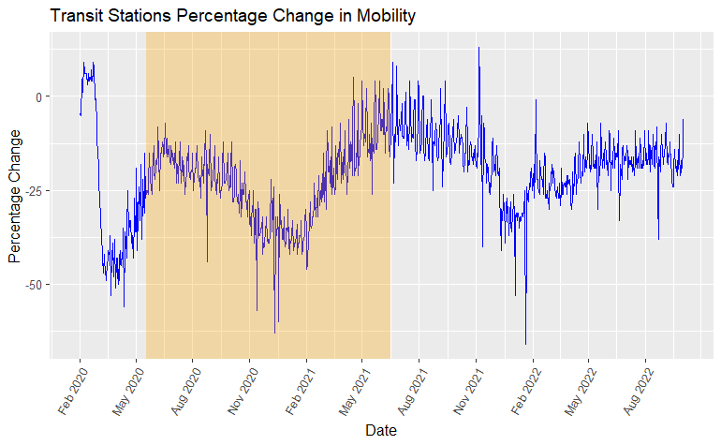
Results
Transit Stations Mobility:
Before mandate: 24.65% less than baseline
During mandate: 24.6% less than baseline
After mandate: 16.94% less than baseline

Slide 11
Key Takeaways
Parks have seen the most dramatic change in mobility overall
Some destinations have dropped in foot traffic because of increased usage of online grocery, food, and shopping delivery services
More workplaces have pivoted towards a remote or hybrid work environment

Slide 12
Why These Results Matter
Overall, people have been leaving their residences after the mask mandate was put in place and after the mandate was lifted
People perceived less risk in getting COVID-19 during these time periods
Observations can be helpful contributions towards behavioral economics if a similar situation like COVID-19 were to arise again

